Slide 1
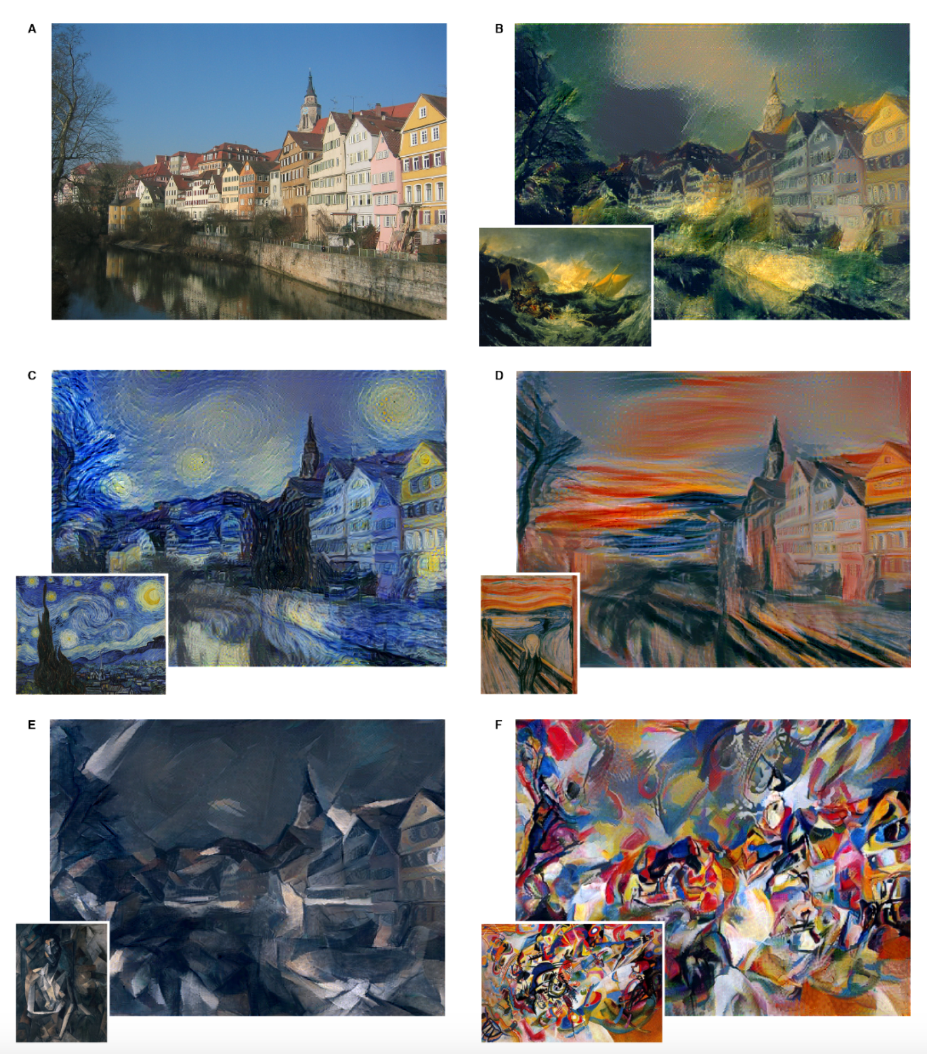
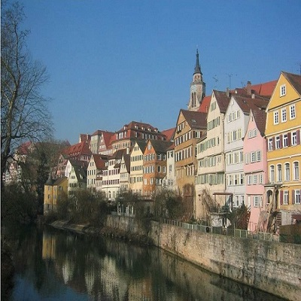
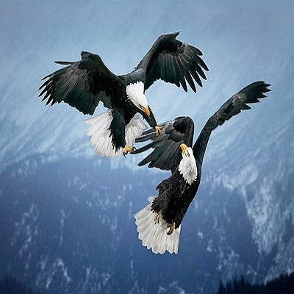

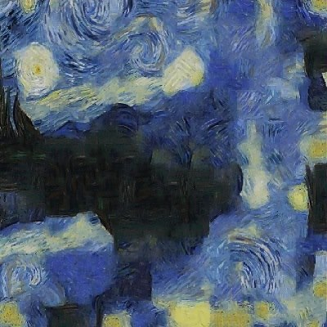
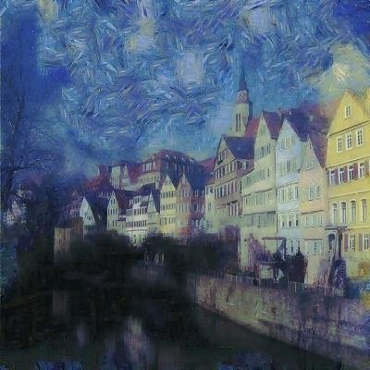
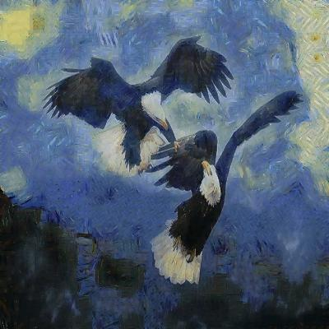
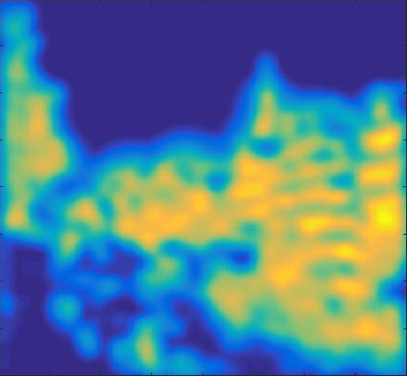
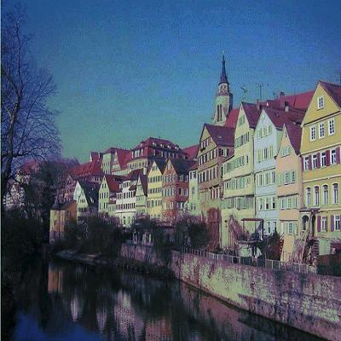
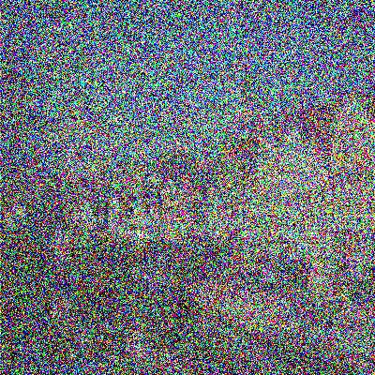
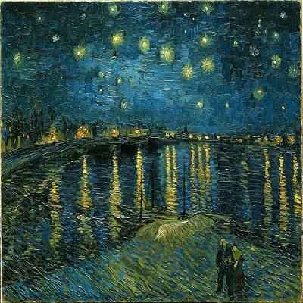
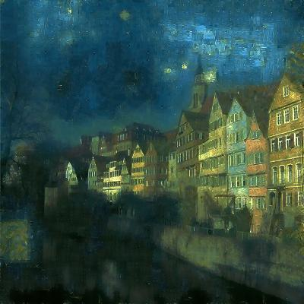
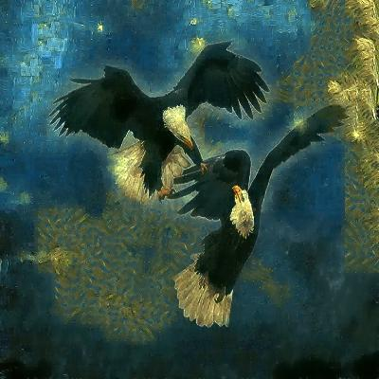
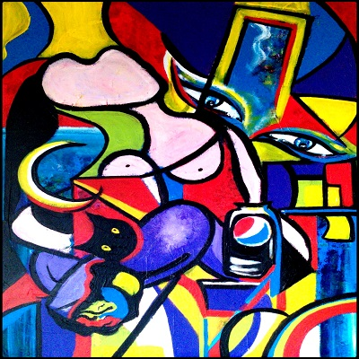
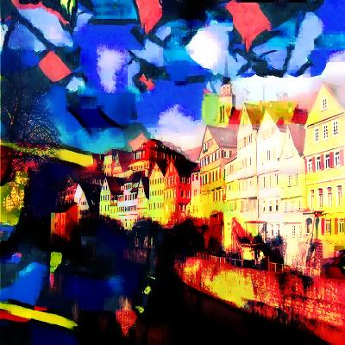
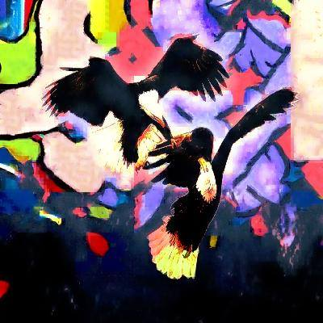
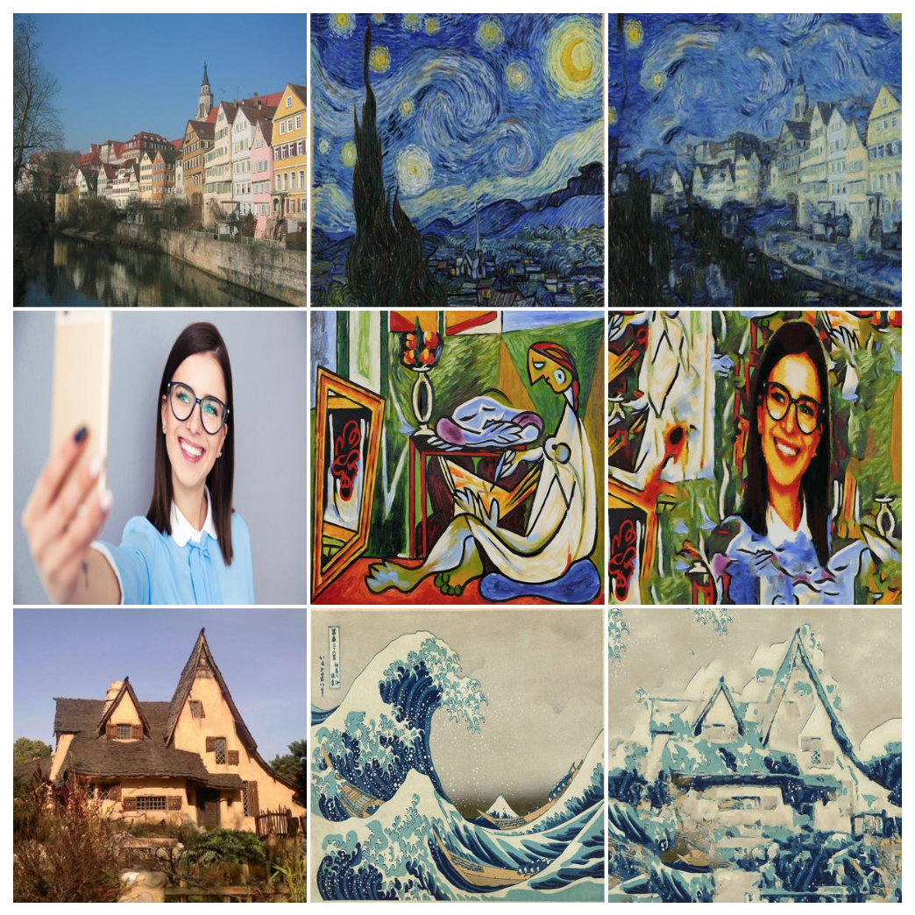

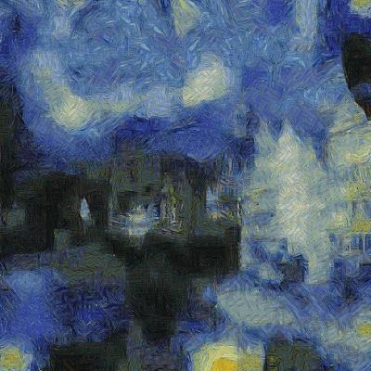
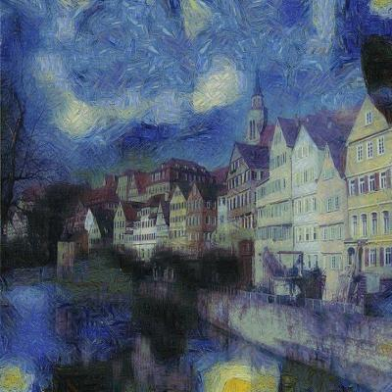
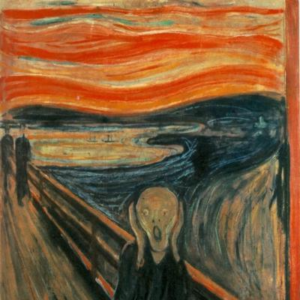
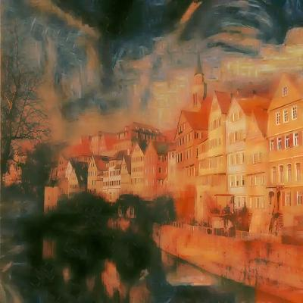
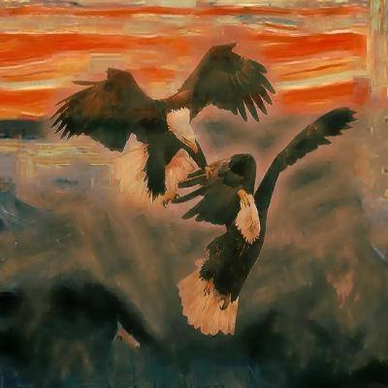
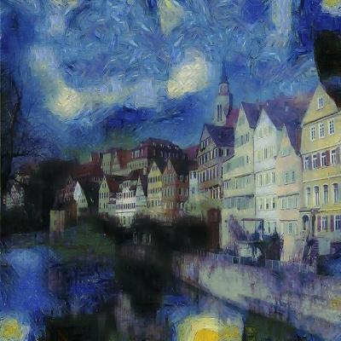
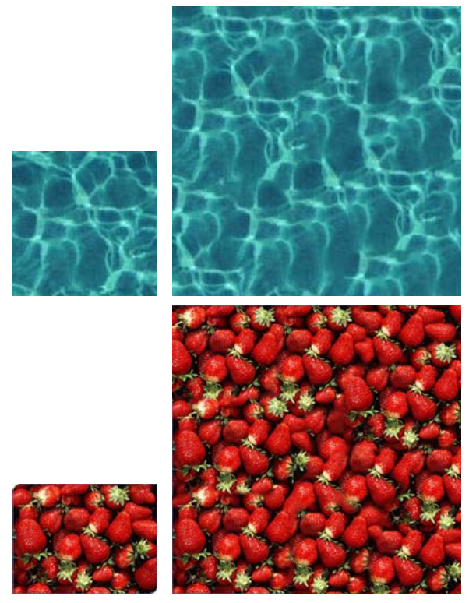
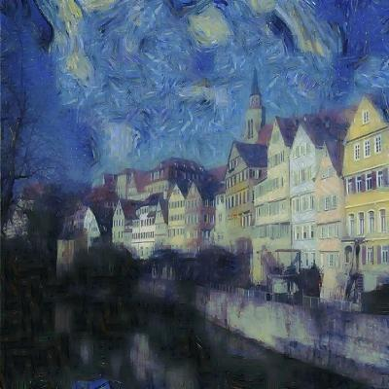
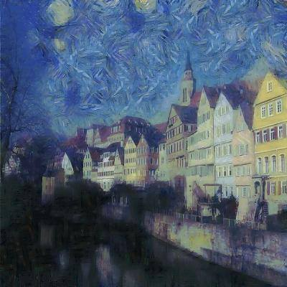
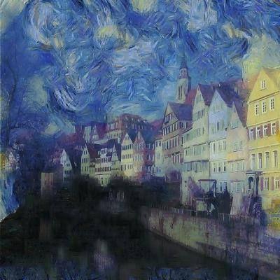
Artistic Style Transfer
Nicholas Tan, Elias Wang
Department of Electrical Engineering, Stanford University
Motivation
Algorithm Overview
Experimental Results
Leon A. Gatys, Alexander S. Ecker, Matthias Bethge
Using a biologically inspired vision model, called “Deep Neural Networks,” an artificial system can be trained to learn different styles of painting and subsequently recreate images rendered in that style.
The model is successful because it is able to distinguish between “style” vs. “content”
Input:
Content Image
Style Image
Hallucination
Chosen parameters: 3 scales, 2 patch sizes (except smallest scale uses 3 patch sizes), 10% NN noise, 25%+75% hallucination averaging
Initialization:
Color transfer
Add noise
Segmentation
Related Work
Using a modification (Elad) of Texture-Synthesis (Kwatra), it is possible to get fast and comparable style-transfer results. This method focuses on separating information-poor areas to hallucinate the style and high content areas where it keeps the original image
Patch matching
Texture Synthesis
Content Fusion
Color Transfer
Denoise
Resize estimate
Hallucination percentage influence :
0%
10%
25%
50%

